Slide 1
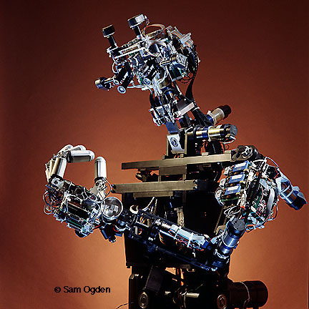
Expert Systems
The Robotic Expert System named Cog

Slide 2
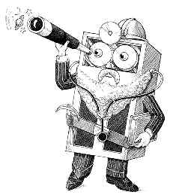
HEADLINES
What is an Expert System?
Applications and Characteristics of an Expert System
Architecture of a typical Expert System
Expert System Shells
Building an Expert System
Case Studies

Slide 3
What is an Expert System?
An expert system is a computer program that is designed to hold the accumulated knowledge of one or more domain experts.
An Expert System (ES) is a computer-based system (mainly software) that uses knowledge and facts, and applies an appropriate reasoning technique (inferencing) to solve problems in a given field (domain) that normally require the services of human experts.

Slide 4
Applications of Expert Systems
Diagnosis and Troubleshooting of Devices and Systems of All Kinds
Planning and Scheduling
Configuration of Manufactured Objects from Subassemblies
Financial Decision Making
And many more

Slide 5
Capabilities of Expert Systems
Strategic goal setting
Explore impact of strategic goals
Planning
Impact of plans on resources
Design
Integrate general design principles and manufacturing limitations
Decision making
Provide advise on decisions
Quality control and monitoring
Monitor quality and assist in finding solutions
Diagnosis
Look for causes and suggest solutions

Slide 6
Components of an Expert System
Knowledge base
  Stores all relevant information, data, rules, cases, and relationships used by the expert system
Inference engine
  Seeks information and relationships from the knowledge base and provides answers, predictions, and suggestions in the way a human expert would
A set of rules
  A Rule is a conditional statement that links given conditions to actions or outcomes

Slide 7
Components of an Expert System, Cont……
Fuzzy logic
  A specialty research area in computer science that allows shades of gray and does not require everything to be simply black/white or yes/no, or true/false.
Backward chaining
  A method of reasoning that starts with conclusions and works backward to the supporting facts
Forward chaining
  A method of reasoning that starts with the facts and works forward to the conclusions

Slide 8
Explanation
facility
Inference
engine
Knowledge
base
Knowledge
base
acquisition
facility
User
interface
Architecture of an
Expert System
Experts
User

Slide 9
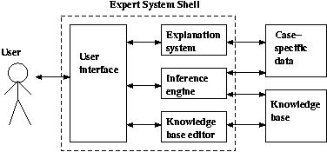
Expert System Shell
  A collection of software packages and tools used to develop expert systems

Slide 10
Development of an Expert System
Determining requirements
Identifying experts
Domain
The area of knowledge
addressed by the
expert system.
Construct expert system components
Implementing results
Maintaining and reviewing system

Slide 11
Building of an Expert System
The process of building an ES is called Knowledge Engineering.
It consists of three stages :
1. Knowledge acquisition : the process of obtaining the knowledge from experts
2. Knowledge representation : selecting the most appropriate structures to represent the knowledge
3. Knowledge validation : testing that the knowledge of the ES is correct and complete

Slide 12

Knowledge Acquisition Facility
  Knowledge acquisition facility
    Provides a convenient and efficient means of capturing and storing all components of the knowledge base
Knowledge
base
Knowledge
acquisition
facility
Expert

Slide 13



Who uses an Expert System?
Expert
system
Knowledge engineer
Domain expert
Knowledge user

Slide 14
Knowledge Acquisition Principles

Slide 15
Knowledge Acquisition
Definition: Knowledge acquisition is the process of extracting knowledge from whatever source including document, manuals, case studies, etc.
Knowledge elicitation is a type of knowledge acquisition where the only knowledge source is the domain expert. Techniques:
– Interviews (unstructured to structured)
– Protocol analysis (on-line, off-line)
– Concept sorting

Slide 16
Architectural Principles
Knowledge is power
Knowledge is often inexact & incomplete
Knowledge is often poorly specified
Amateurs become experts slowly
Expert systems must be flexible
Expert systems must be transparent
Separate inference engine and knowledge base (make system easy to modify)

Slide 17
Architectural Principles
Use uniform "fact" representation (reduces number of rules required and limits combinatorial explosion)
Keep inference engine simple (makes knowledge acquisition and truth maintenance easier)
Exploit redundancy (can help overcome problems due to inexact or uncertain reasoning)

Slide 18
Criteria for Selecting Problem
Recognized experts exist
Experts do better than amateurs
Expert needs significant time to solve it
Cognitive type tasks
Skill can routinely be taught to neophytes (beginners)
Domain has high payoff
Task does not require common sense

Slide 19
How are they built?
Process is similar to rapid prototyping (expert is the customer)
Expert is involved throughout the development process
Incremental systems are presented to expert for feedback and approval
Change is viewed as healthy; not a process failure

Slide 20
Roles
Domain Expert
  customer
  provides knowledge and processes needed to solve problem
Knowledge Engineer
  obtains knowledge from domain expert
  maps domain knowledge and processes to AI formalism to allow computation

Slide 21
KA is Tricky
Domain expert must be available for hundreds of hours
Knowledge in the expert system ends up being the knowledge engineer’s understanding of the domain, not the domain expert’s knowledge

Slide 22
KA Techniques
Description
  expert lectures or writes about solving the task
Observation
  KE watches domain expert solve the task unobtrusively
Introspection
  goal-directed KE tries to find out which goal is being accomplished at each step

Slide 23
KA Difficulties
Expert may not have required knowledge in some areas
Expert may not be consciously aware of required knowledge needed
Expert may not be able to communicate the knowledge needed to knowledge engineer
Knowledge engineer may not be able to structure knowledge for entry into knowledge base.

Slide 24
KA Phases
Identification Phase
  scope of problem
Conceptualization Phase
  key concepts are operationalized and paper prototype built
Formulation Phase
  paper prototype mapped onto some formal representation and AI tools selected
Implementation Phase
  formal representation rewritten for AI tools

Slide 25
KA Phases
Testing Phase
  check both "classic" test cases and "hard” “boundary” cases
  most likely problems
    I/O failures (user interface problems)
    Logic errors (e.g. bad rules)
    Control strategy problems
Prototype Revision

